Slide 1
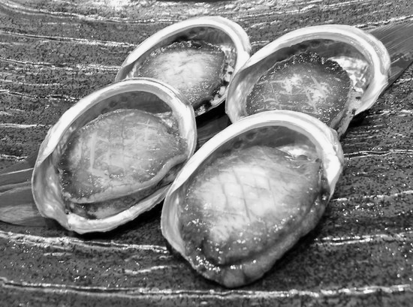
Topic: Can we predict the sex of an abalone by its physical characteristics?
By Leroy Maswaure

Slide 2
Background information of abalones
It is a very common type of shellfish
Its shell is mainly used for jewelry and its flesh is eaten
It is proven that the rings of the shell of an abalone can predict its age, so in this case the rings will be our age variable

Slide 3
Data set information
The data set was retrieved from Kaggle
List Of Variables
X
Length ( longest shell measurement)
Diameter ( perpendicular to shell length)
Height ( with meat in shell )
Whole weight ( whole abalone)
Shucked weight ( weight of meat )
Viscera weight ( gut weight after bleeding)
Shell weight ( after being dried)
Rings ( +1.5 gives us age in years ) (age)
=
Sex

Slide 4
HYPOTHESIS
The whole weight of an abalone can predict its sex ( either male, female or infant ). Because when I checked the first row of data most females weighed more than their male counterparts.
That rings on shell of abalone can predict sex of an abalone. According to data from Abalone researchers you can tell sex by the colour of rings on an abalone. Typically, females usually have blue rings.

Slide 5
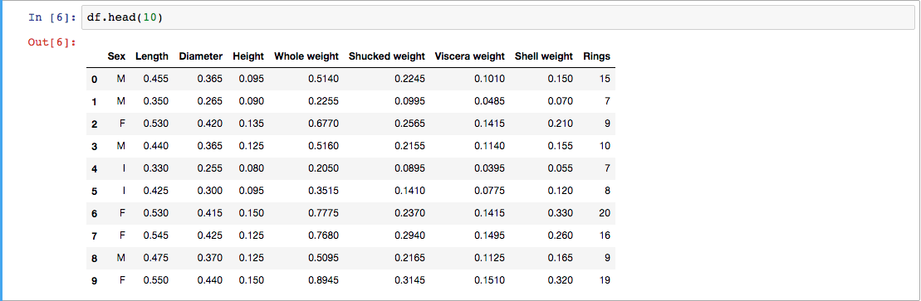
Data analysis
I analyzed the first 10 rows of data

Slide 6
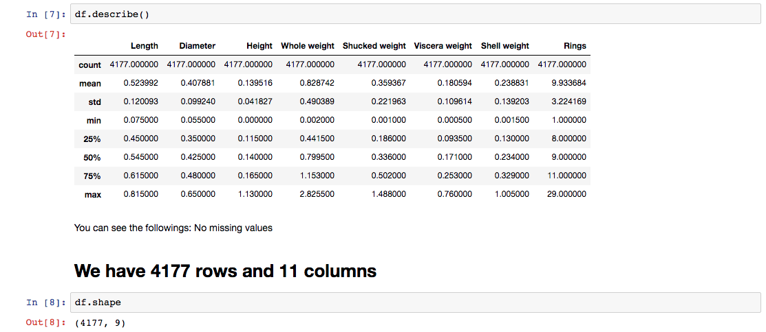
The data has 4177 rows and 11 columns, and the count shows us that the data has no missing values.

Slide 7
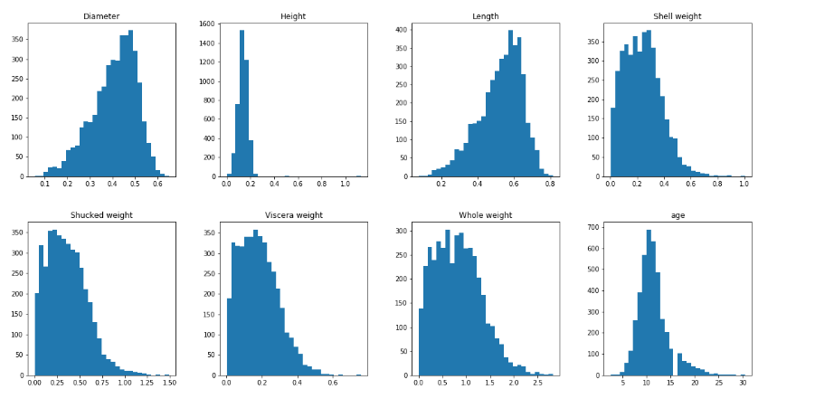
DISTRIBUTION OF DATA
After data analysis, I had to study the distribution of various variables. In order to do that, I had to plot a few visual graphs.

Slide 8
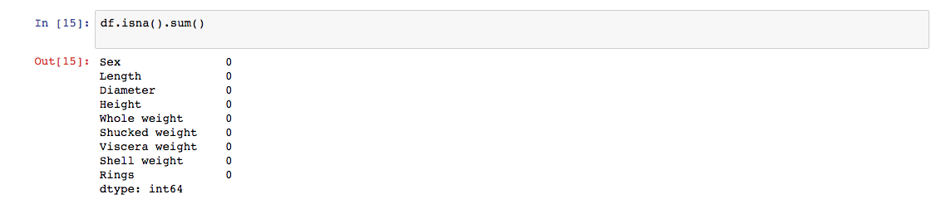
Data cleaning
After data distribution, I just had to double check if there really were not any missing values.

Slide 9
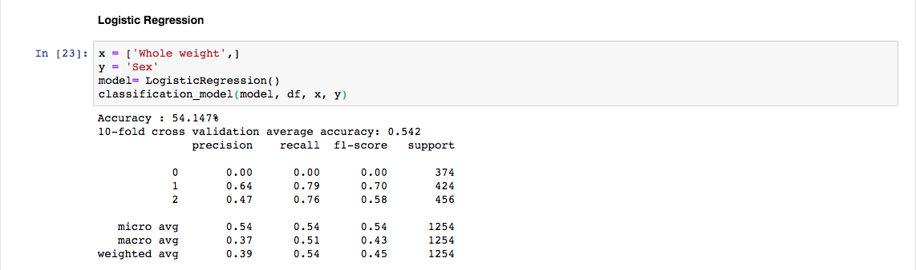
Time to check our first hypothesis using Logistic regression
Hyp 1:
The whole weight of an abalone can predict its sex ( either male, female or infant )

Slide 10
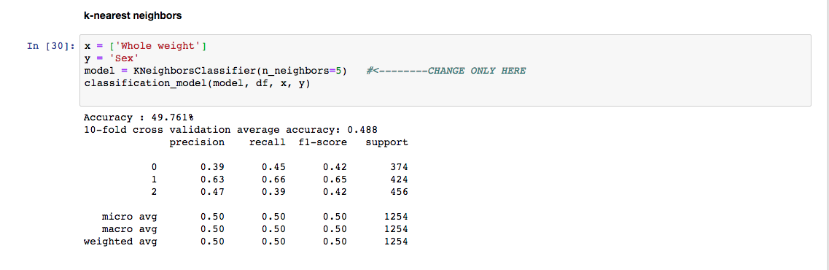
Time to check our first hypothesis using KNN
Hyp 1:
The whole weight of an abalone can predict its sex ( either male, female or infant )

Slide 11
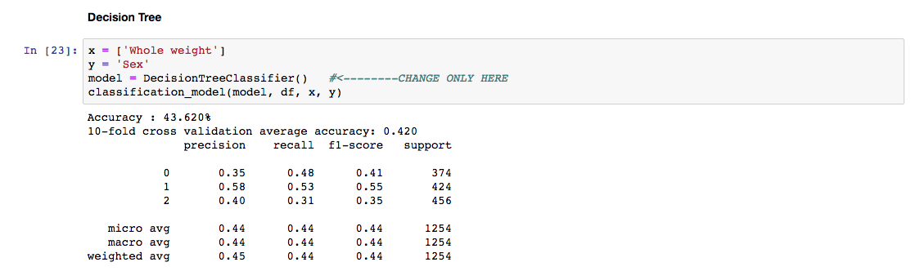
Time to check our first hypothesis using Decision Tree
Hyp 1:
The whole weight of an abalone can predict its sex ( either male, female or infant )

Slide 12
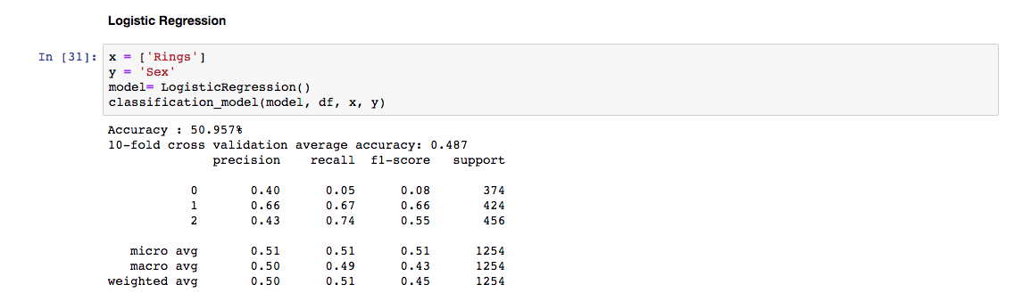
Time to check our 2nd hypothesis using Logistic regression
Hyp 2:
That rings on shell of abalone can predict sex of an abalone

Slide 13
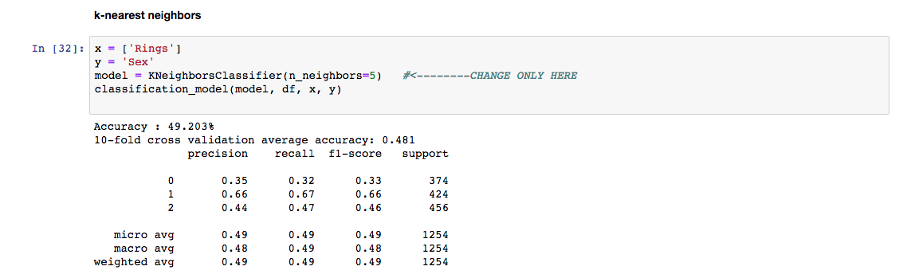
Time to check our 2nd hypothesis using KNN
Hyp 2:
That rings on shell of abalone can predict sex of an abalone

Slide 14
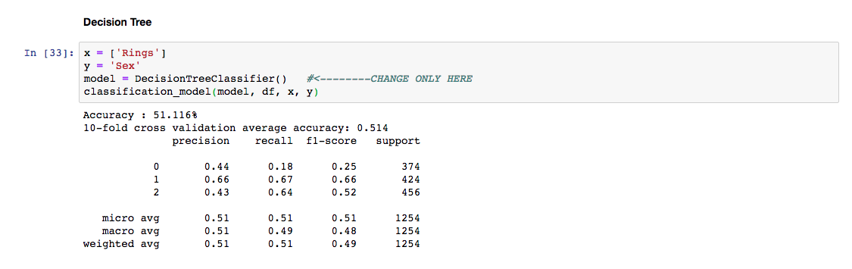
Time to check our 2nd hypothesis using Decision tree
Hyp 2:
That rings on shell of abalone can predict sex of an abalone

Slide 15
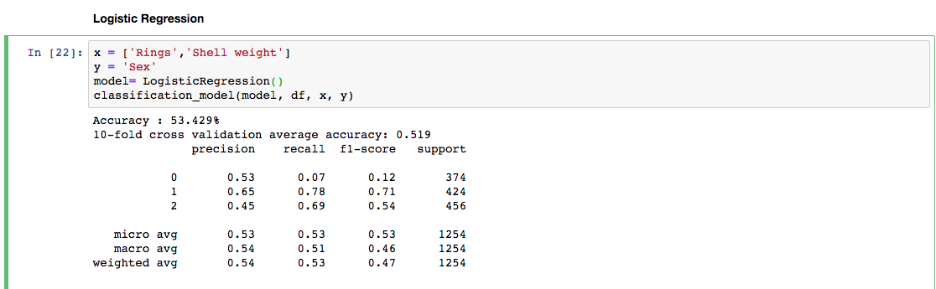
Time to add more X to Logistic regression which corelate to see if models give us better scores
That rings and shell weight of abalone can predict its sex.

Slide 16
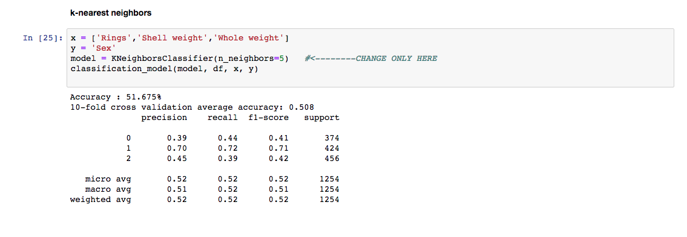
Time to add more X to KNN which corelate to see if models give us better scores
That rings and shell weight of abalone can predict its sex.

Slide 17
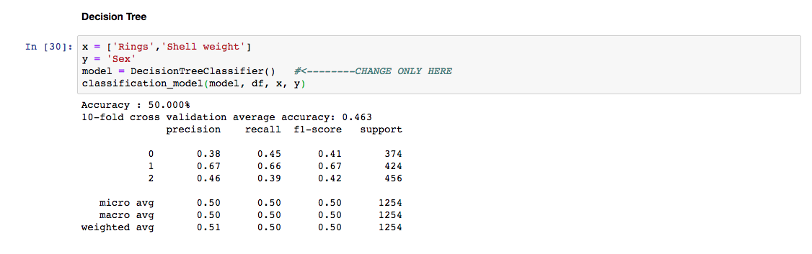
Time to add more X to Decision tree which corelate to see if models give us better scores
That rings and shell weight of abalone can predict its sex.

Slide 18
Conclusion for hypothesis one results
To conclude, I was overall satisfied with the results, which the logistic regression had provided. With using recall the data set is serious considering my assumption of the true negatives so my outcome was not clear. KNN data seemed to not be static meaning that data is not fixed and has a possibility of changing. Bearing in mind the existence of a vast number of alternative, more sophisticated and usually more successful classifying techniques.

Slide 19
References
https://www.kaggle.com/yuridias/predicting-abalone-s-sex-with-logistic-regression
https://www.theatlantic.com/health/archive/2010/03/how-to-sex-an-abalone-a-sea-snails-story/37198/

